Slide 1
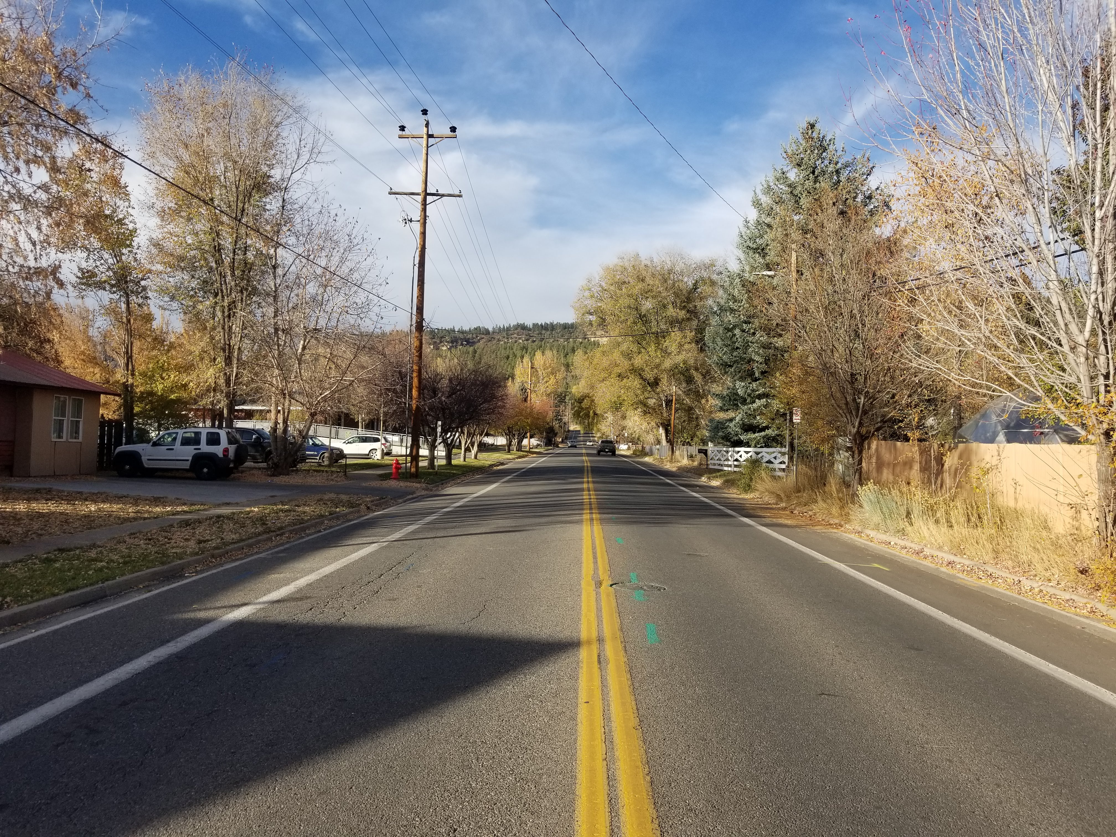


September 23, 2024
Junction St Traffic Calming 60% Meeting
Devin King, Multimodal Manager
Steve Pavlick, PST
Holden Rennaker, PST

Slide 2

Welcome & Presentation
Question & Answer
Open house
Agenda
Notes:
This was intended for public speaking, but the suggestions apply to all communications within the PIO office: Talking to the media, writing an email, calling someone on the phone, even sending a text.

Slide 3
This is a call to honor and respect Indigenous sovereignty and self-determination. As residents and visitors of Durango, we are called upon to educate ourselves about the history and cultural heritage of the land we inhabit. The City of Durango is situated on the ancestral homelands and territories of the Nuuchiu (Ute), Jicarilla Apache (Apache), Pueblos of New Mexico, Hopi Sinom (Hopi), and Diné (Navajo) Nations. The original stewards of this land were forcibly removed and exposed to countless atrocities by the United States government, including repeatedly broken treaties, forced assimilation, the tragic legacy of Indian boarding schools, and the loss of ancestral homelands. We recognize lasting generational trauma exists within native communities today. We affirm the continuing importance of ancestral sites to descendant communities as integral to the living cultural landscape.
This acknowledgment only becomes meaningful when combined with accountable relationships and informed actions. May this serve as a step towards inclusion and reconciliation.
Indigenous Land Acknowledgement
Notes:
This was intended for public speaking, but the suggestions apply to all communications within the PIO office: Talking to the media, writing an email, calling someone on the phone, even sending a text.

Slide 4
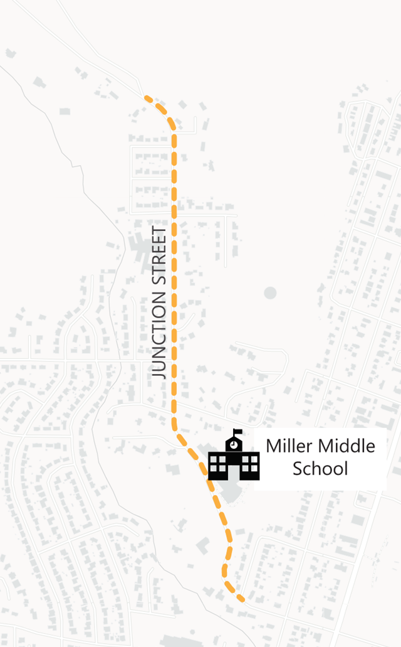
Project purpose & scope
Purpose
Improve traffic safety along Junction Street
Improve connectivity and accessibility for cyclists and pedestrians
Scope
Junction Street from W 2nd Ave to Dalla Mountain Park
Roadway improvements including drainage

Slide 5
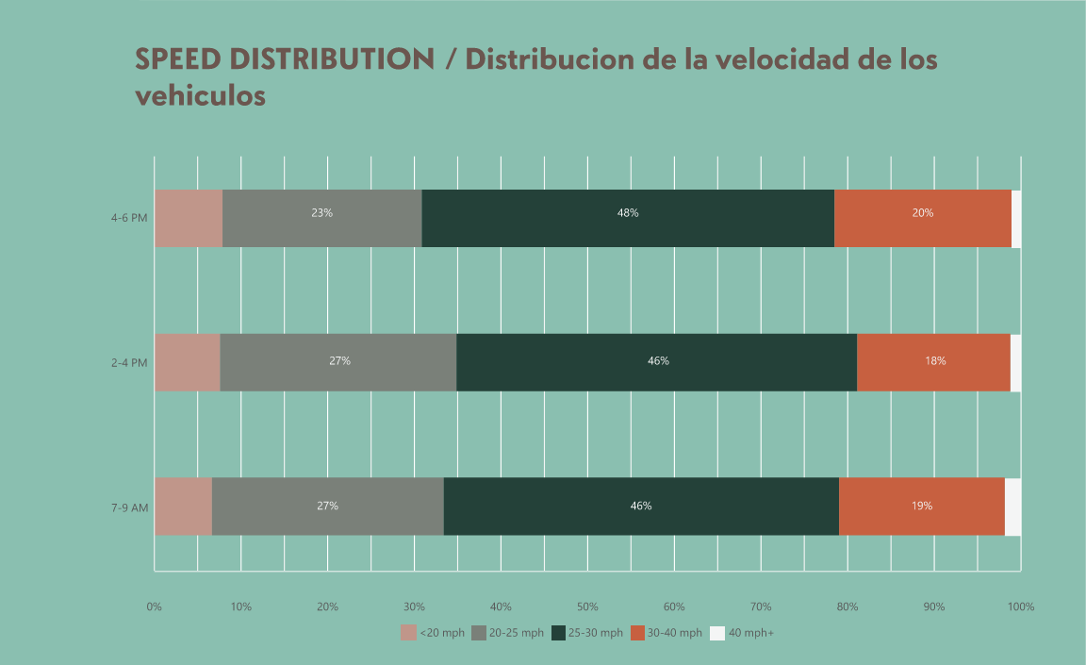
Existing conditions
Crashes
  6 reported since 2018
Speeds
  Speed limit is 25 mph
  Up to 20% travelling over 30 mph
Incomplete sidewalk connectivity on corridor
Cycling facilities
  Shared lane to Miller
  Bicycle lanes after Miller to Dalla

Slide 6
Project Timeline
Project prioritized by Multimodal Advisory Board
Funded for design in 2023 Budget
Visioning meeting in October 2023 – 54 attendees
Conceptual design meeting in December 2023
Survey for concept alternatives in November 2023 – 122 responses
Incorporated feedback into 60% design

Slide 7
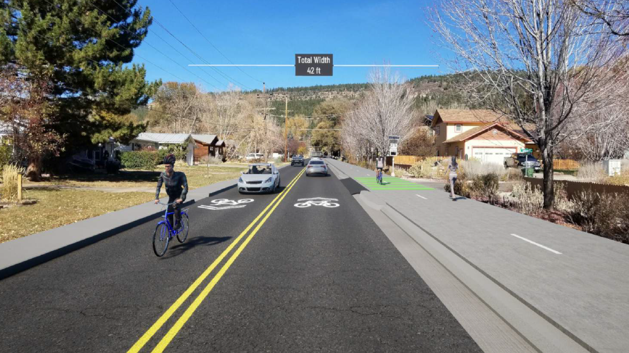
Design alternatives and feedback
Survey
Alternative 2 most preferred
Meeting feedback
Alternative 2 supported
Mini-roundabout at Clovis
Raised crosswalk at Sunnyside
Connection to Dalla
4 alternatives

Slide 8
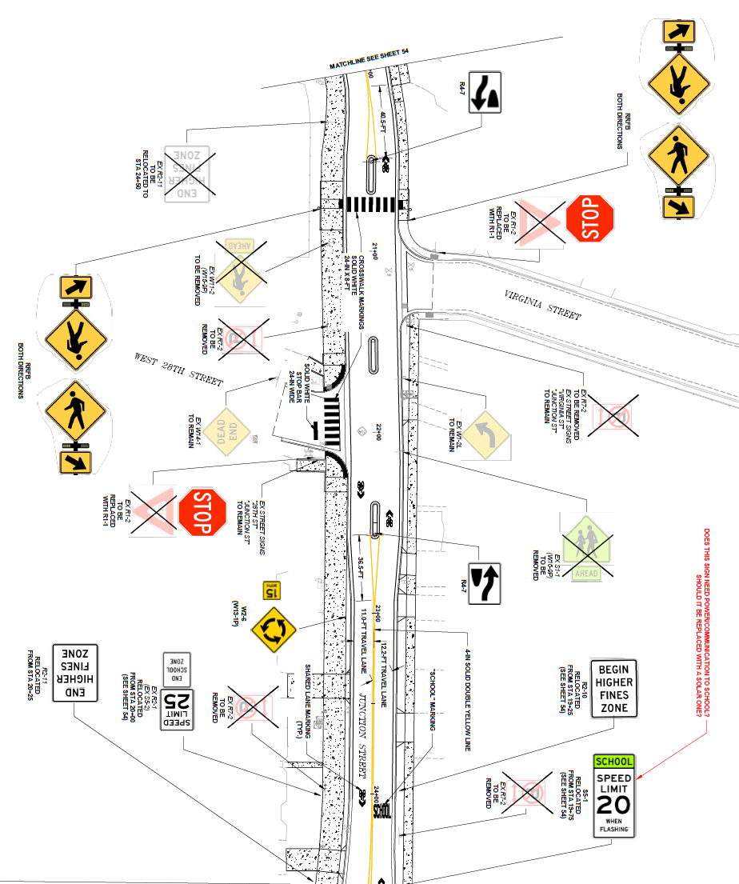
Design
Pedestrian Improvements
Enhanced crossings
Connected sidewalks
Cycle Improvements
8-12 – foot shared use path
Shared lane for those that want to ride on road
Traffic Calming Improvements
Narrowed lanes
Lateral movements with medians
Improved curb ramps
Mini-roundabout

Slide 9
What’s next
Incorporate feedback into 90% plans
Create construction documents
Construction in 2025

Slide 10
Question & Answer
Questions only
Be respectful of others and time
Raise hand and we’ll provide microphone

Slide 11

Open house
Roll plots of design are in back
Sticky notes are available for feedback and comment
  Specific comments are preferred
Staff is available for feedback and to answer questions
Virtual attendees can provide comments on the Engage Durango web page linked in the chat

